Slide 1
Improving services for child victims of domestic abuse

Slide 2
Understanding the state of play: Our methodology
Review of reviews
Call for evidence
Review of grey literature
What do we know about what works to support children affected by domestic abuse?
What do we know about the challenges of impact evaluation?
What is the context and how does this affect evaluation and the use of evidence?
Notes:
Each programme identified has been through an in-depth extraction, scoring and quality assurance process to determine the maturity of its evaluation approach and the extent to which the programme can be seen to impact child outcomes. This process is based on our evidence standards. The findings show that there is currently a significant lack of intervention evidence in relation to supporting children affected by domestic abuse.

Slide 3
Strength of Evidence (UK)
Study Design
Validated Measures
Robustness Score
Notes:
107 programmes were found but only 24 had published evaluations
Robustness score – 0-3.
Our work found just three projects that had a robust study design. Two of these had been evaluated using an RCT design. These were Project Crewe/FACT22 and Family Nurse Partnership, although their outcomes were not specific to the domestic abuse context. .
One further project, the NSPCC’s DART programme, was evaluated using a robust quasi-experimental design which did show evidence of effect. The DART Programme was considered the most robust programme identified in our search.

Slide 4
Summary
Programmes with the strongest evidence have yet to be tested in a UK context. Instead, all have been tested in the US.
Many UK programmes have yet to be evaluated. Where they have, tends to be either internal evaluations or feasibility studies.
Where evaluations have been published, methodological issues exist which ultimately mean that we cannot attribute any change in child or parental outcomes to the intervention itself.
RCTs and QEDs are limited in number within the UK context.
Evaluation commonly weakened by:
Small sample sizes
Reliance on qualitative data
High attrition
Lack of consideration of long term change.
Notes:
small sample sizes, often lower than 40 individuals, including staff members, impeding external validity and often meaning that testing for significance or effect sizes is impractical. Instead, evaluations rely heavily on qualitative data which bring with it a number of biases (e.g. confirmation bias, social desirability bias). Attrition also tends to be relatively high, and in many instances, it is unclear how those who remained in the evaluation differed from those who left at baseline. This again, limits the external validity of conclusions and only offers insights to a particular sub-group of the population at large. Lastly, evaluations tend to look at change over a relatively short period of time (e.g. before/after an 8-week programme) and it is currently unclear if change observed is retained in the long-term.

Slide 5
Understanding the state of play
What do we know about what works to support children affected by domestic abuse?
What do we know about the challenges of impact evaluation?
What is the context and how does this impact on evaluation and the use of evidence?
Brief literature review
Interviews with experts

Slide 6
Challenges relating to impact evaluation
Provider concerns over the appropriateness of RCTs
Cost and resource implications of trying to measure long-term outcomes
Lack of consensus on the most relevant and appropriate outcomes to measure. Hampers attempts to synthesise evidence across studies.
Implementation challenges, including participant recruitment and retention; need for flexible and responsive services; need to consider a child’s developmental stage
Notes:
Outcomes point: (including: service delivery is intentionally individualised and client-directed; tailored to individual need therefore clients may have different goals. Standard outcomes may miss important intervention impacts). Emphasis on children’s symptoms and disorders rather than the wider range of positive outcomes relating to their health and wellbeing.
Our overall view is that these are certainly challenges, but that none of them are insurmountable, and that it is right for us to seek evidence of impact for interventions delivered to highly vulnerable families.
Still a pressing need for more well-conducted, well-designed RCTs.
First, the appropriateness of randomised control trials — or RCTs — is contentious, both within the domestic abuse field and in relation to support for vulnerable children more generally. These methods have been challenged on ethical grounds, given that the study design requires a comparison group of children who do not receive the support or intervention. There are also practical concerns, that these methodologies impose an additional burden on an already struggling system.8
These are valid and important concerns. There are, however, routes to testing effectiveness that don’t result in services being We must Close unacceptable gaps in the evidence of what works “To date, there has been very little robust impact evaluation of programmes or practices in the UK. Improving services for children affected by domestic abuse 5 withheld from children, and making greater use of experimental methods in order to establish a clearer picture of the impact of services in this territory is important. Experimental methods provide us with the best way to establish causality and to know which interventions work. We need to make progress in evaluating promising interventions, and interventions that are already widely-used in the UK, so we can support children affected by domestic abuse with services that have been shown to make a difference
The current work being led by University College London and funded by the National Institute for Health Research to develop a common set of outcomes takes a vital step towards greater consistency in measurement approaches. Importantly, this work involves survivors, practitioners, commissioners and policy makers to ensure that the outcomes selected reflect the priorities of different stakeholder groups.

Slide 7
Understanding the state of play
What do we know about what works to support children affected by domestic abuse?
What do we know about the challenges of impact evaluation?
What is the context and how does this impact on evaluation and the use of evidence?
Interviews with experts
Qualitative work and system mapping in 4 local areas

Slide 8
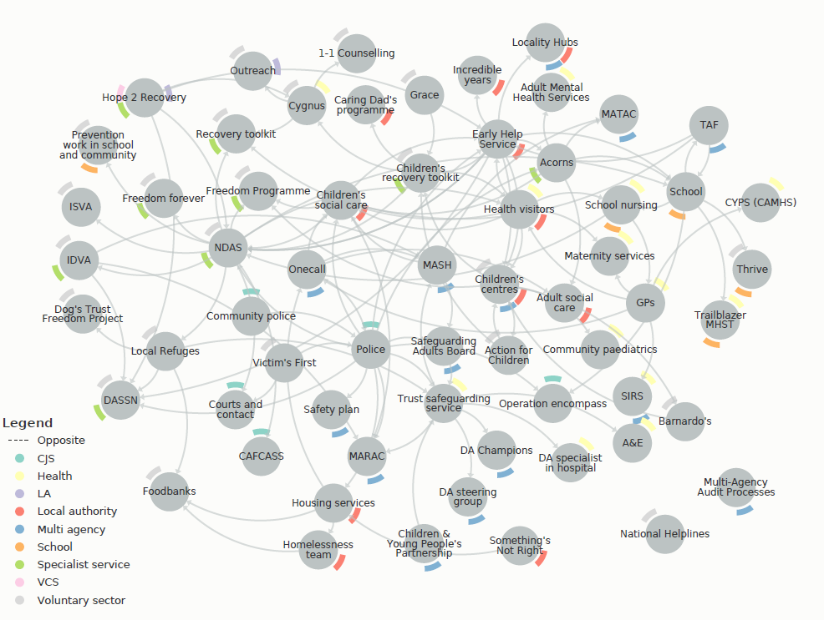
Understanding the context
Notes:
We have been working with four local places to understand their priorities in relation to children who experience domestic abuse, and the nature and availability of support for these children. This work has exposed a raft of system challenges which are impacting on the quality and availability of this essential support.
We know, for example, that local authority funding constraints remain a major challenge to the provision of local services. Directors of Children’s Services across the country are trying to balance budgets and rationalise services, whilst retaining the most effective support offer possible for children and families. Statutory services are focussing on crisis support and reducing the immediate risk of harm to children, whilst authority funding for prevention activity or longer-term therapeutic support is short term and vulnerable to cuts. Many of these wider services are provided by the voluntary and community sector and are propped up by piecemeal funding from a range of sources, leaving them in a precarious position. In summary, demand for support commonly outstrips supply, and children are missing out on the kind of help that can be vital to their health and wellbeing.
Gaps in provision.

Slide 9
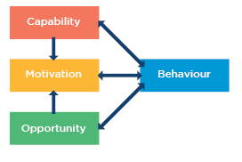
Evaluation and evidence use within this context
Michie et al. 2014
Notes:
funding and carrying out local evaluations in the context we have described is incredibly challenging.
Lack of clear, long-term evidence-informed strategies
Priority given to qualitative evidence and family experience
“Something better than nothing” approach to referral
Data not always shared appropriately or consistently – limits local needs assessment
Lack of understanding of what works, esp. in practice – leads to sense of ‘design by doing’?
Tendency to think of evidence as just about programme evaluation
Belief in the ‘status quo’ and long-established services
Philosophical positions
Funding constraints
Gaps in provision
Implementation challenges
Non-commissioned nature of much service provision
Lack of specificity of service design, roles, responsibilities

Slide 10
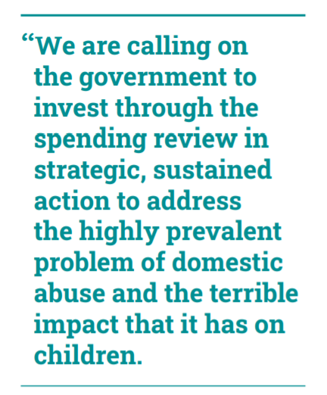
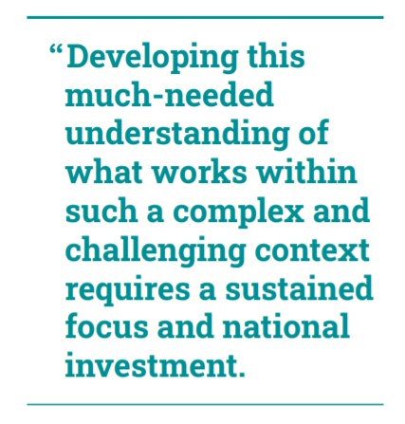
Our policy call
Notes:
Local councils cannot resolve these systemic issues on their own. We are calling on the government to establish a long-term cross-departmental fund dedicated to improving our understanding of what works and supporting the use of this knowledge in local service delivery. This fund should invest in robust impact evaluation of the most promising and widely delivered programmes, building our understanding of the nature of approaches that are proven to be effective. The fund should also respond to the current reality of local systems and build capacity to evaluate small scale, local programmes, as well as practice-based approaches and system improvements.

Slide 11
Supporting evaluation and improvement: thoughts
More work to understand values and attitudes to evidence use: Need to align evidence use and evaluation with service delivery.
Need for specification and ‘visibility’ of existing activity. Case study exemplification.
Supporting intervention development and strengthening implementation.
User led: Rooting this in work with communities from a position of understanding what matters to them.
In the absence of knowing what works, what do we have data, intelligence or insight on?
Supporting early stage evaluation: using the right kinds of evaluation approaches. Avoiding the application of too demanding an evaluation model too early on.

Slide 12
https://www.eif.org.uk/report/improving-services-for-children-affected-by-domestic-abuse

Slide 13
Strength of Evidence Criteria
Strong study design which permits causality
Significant finding on a child outcome
Validated measures used
Sample > 20
60% of sample retained
AND
Systematic review does not identify any major limitations*
Self-designed strength of evidence criteria used.
Loosely matched to EIF Evidence Standards
Pre/post design
Significant finding on child outcome
Validated measures
Sample > 20
60% of sample retained
Weak study design
Non-validated measures
Sample size < 20
Attrition rate > 60%
OR
Robust design but no significant child outcomes
3
3
2
2
1
No impact evaluation
0
Notes:
Rating
Definition
Score 3 – ‘Robust data’
It meets the following requirements:
Strong study design - evaluation design permitting causal inference i.e. randomised control trial, quasi-experimental designs
Significant findings on a child outcome.
Validated measures – measures ae validated
Low attrition and reasonable sample size – i.e. study does not have a sample of at least 20 participants with at least 60% of the sample retained.
Exception (systematic review risk of bias reporting) - In some cases, some programmes meeting the L3 requirements described above have been put into Level 2, when:
The Systematic Review explicitly reports on risk of bias and limitations of studies.
The Systematic Review identifies a limitation (this includes anything described as a limitation, so long as it doesn’t contradict the items specified above – e.g. if the SR authors describe a sample size of 30 as a limitation, this is not grounds for a downgrade to L2).
Score 2 – ‘Adequate data’
The intervention impact data from a lower-quality evaluation, this may include outcome data and/or pre-post test data. It meets the following requirements:
Significant findings on a child outcome.
Validated measures – measures are validated
Low attrition and reasonable sample size – i.e. study does not have a sample of at least 20 participants with at least 60% of the sample retained.
It does not meet the following requirements:
Strong study design - evaluation design permitting causal inference i.e. randomised control trial, quasi-experimental designs
Exception (systematic review risk of bias reporting) - In some cases, some programmes meeting the L3 requirements – including the ‘strong study design’ requirement above - have been put into Level 2, when:
The Systematic Review explicitly reports on risk of bias and limitations of studies.
The Systematic Review identifies a limitation (this includes anything described as a limitation, so long as it doesn’t contradict the items specified above – e.g. if the SR authors describe a sample size of 30 as a limitation, it need not to be downgraded to L2).
Score 1 – ‘Limited data’
Study fails to meet the following requirements:
Acceptable study design – i.e. the study design is not a comparison group study or a one-group pre-post study.
Validated measures – measures aren’t validated
Low attrition and reasonable sample size – i.e. study does not have a sample of at least 20 participants with at least 60% of the sample retained.
OR Impact data is collected in a robust way but shows no significant findings on child outcomes.
Score 0
No impact evaluation.

