Slide 1
Researcher/Artist Collaboration Small Grant Competition

Slide 2
Overview
Researcher-Artist collaborations that engage the wider public around violence, abuse and mental health, centering lived experience.
All projects must include a lead artist and a lead academic and ensure lived experience engagement is included.
It is expected that final works are produced and public engagement activities are included in the projects proposed.
We anticipate funding 3-5 projects with £10,000-15,000 for 6-9 months (which must be concluded by 31st January 2023).
Applications will close on 4th March 2022 at 17.00.

Slide 3
Approaches
· Arts experiences
· Illustrative projects
· Interactive projects
· Participatory projects
Applications should demonstrate how their proposal is grounded in arts-based approaches.
Art is broadly defined and may include, but is not limited to: painting, graphic design, illustration, sculpture, literature, film, music, theatre, fashion, textiles, new media art, street art, and graffiti art.

Slide 4
Questions of Interest
· How can we name types of experiences that better reflect the real-world complexity of violence and abuse?
· How can survivors be supported to recognise their experiences as abuse?
· What are the long term and wider impacts of violence and abuse on all aspects of a person’s life?
· What is the impact of victim blaming and cultures of disbelief?
· What is the impact of witnessing violence and abuse?
· How can cultures/subcultures which are particularly influenced by taboos and silencing be included in research, activism, and prevention?
· How can we create cultures / safe environments for people to speak about violence and abuse?
· What is the evidence base for the interventions that survivors often find helpful (e.g. peer support, trauma-informed yoga, dance therapy) and how can this evidence base be expanded?
· How can survivors learn from one another’s successful coping and survival strategies?
More information on lived experience priorities can be found here.

Slide 5
Networking/Q&A event:
Networking event 1: 10-11.30am on the 15th December 2021
To find out more email vamhn@kcl.ac.uk.
To register your attendance for this session, please sign up on Eventbrite here: https://www.eventbrite.co.uk/e/vamhn-arts-competition-networking-event-1-tickets-213799328547?aff=affiliate1 .
Networking event 2: 10-11.30am on the 21st January 2022
To find out more email vamhn@kcl.ac.uk.
To register your attendance for this session, please sign up on Eventbrite here.: https://www.eventbrite.co.uk/e/vamhn-arts-competition-networking-event-2-tickets-213821484817?aff=affiliate1

Slide 6
Webinars with the Network’s Lived Experience Advisory Group
The Network’s Lived Experience Advisory Group (LEAG) will host a webinar on the 17th January from 10.30am-12pm.
To register your attendance, follow this link: https://www.eventbrite.co.uk/e/vamhn-lived-experience-advisory-group-session-arts-competition-tickets-214694616377?aff=affiliate1

Slide 7
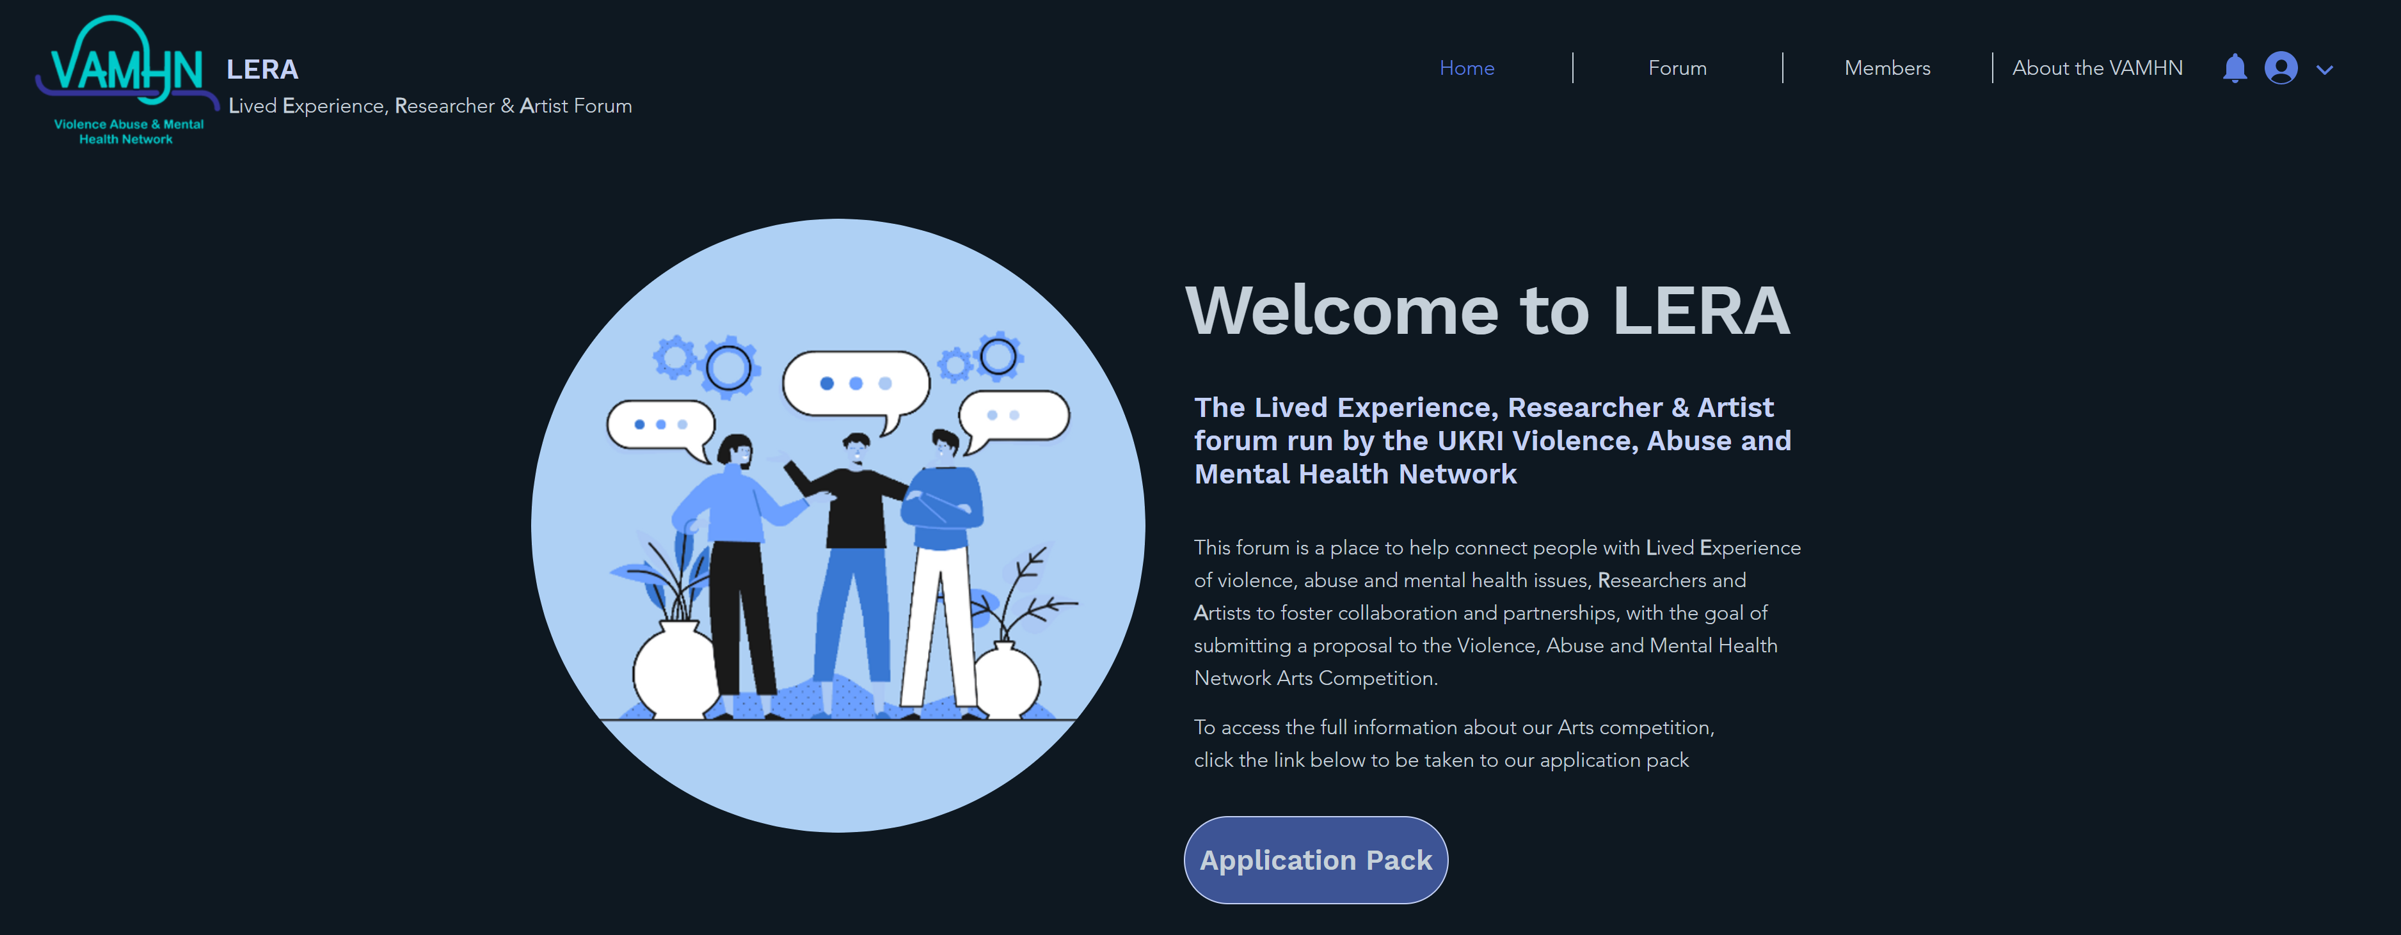
https://leraforum.wixsite.com/my-site/forum-1

Slide 8
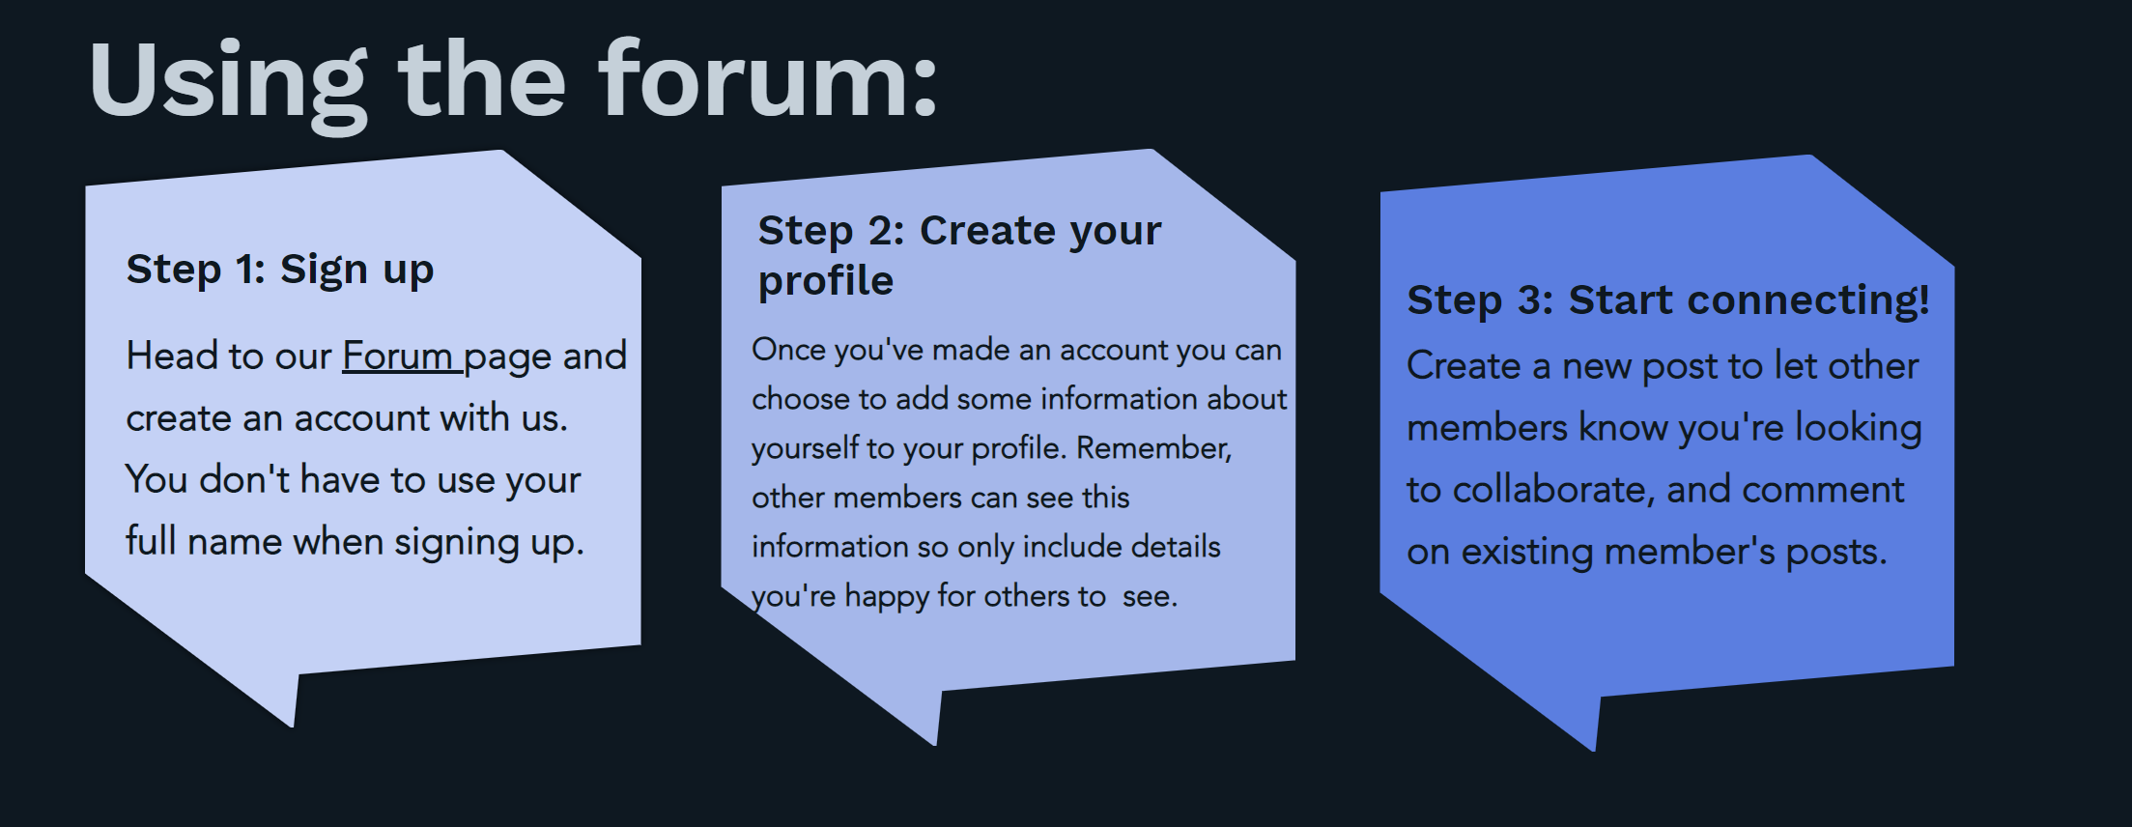

Slide 10
More Information
The brief and application pack are available:
https://www.vamhn.co.uk/vamhn-arts-funding-competition.html
Applications are submitted online here:
https://qualtrics.kcl.ac.uk/jfe/form/SV_3Iq8X5FBPUPQpVk

