Slide 1
Lisa Ward - Survivor/Lived Experience Involvement Consultant

Slide 2
Background & Role
Lived experience
Research based experience
Practice based experience
A CEO of a Rape Crisis Centre
A ‘lived experience’ consultant and researcher
A survivor
Prior experience in the mental health sector (both as a ‘service user’ and a professional)
Notes:
More than a decade in the sector, also a trustee of Rape Crisis England and Wales and previous a trustee of the National Self Harm Network.
Research is on survivor engagement in 3rd sector organizations, specifically VAWG ones

Slide 3
The Lived Experience Advisory Group
8 survivors from various backgrounds all with lived experience of violence and abuse and mental ill-health, supported by the LEAG Consultant.
Meet on a bi-monthly basis to help inform the work of the VAMNH
Notes:
ensuring lived experience is embedded throughout the work of the network, including providing a sounding board to questions the network has, commentaries on journal articles, shaping the grant criteria, and scoring the applications.

Slide 4
3rd Round Grant - interventions
Concept note co-produced with members of the LEAG.
Key considerations:
Meaningful involvement of those from lived experience and 3rd sector organisations
Appropriately costed time
Notes:
Recognise many researchers have their own LE, but also needs to involve others, from start to finish – this should cover the concept of the research through to dissemination (e.g. as co-collaborators on funding applications and designs and co-authors on papers. Also consideration of support/supervision needs (of all researchers)
Outlined by the National Institute for Health Research but will also be looking for people who have considered all costs – e.g. important to bear in mind those with LE may need extra prep time – should also consider the costs to individuals in terms of preparing for bids time wise, and ensure that this is factored in (i.e. don’t send the draft bid to someone with 3 days to go)

Slide 5
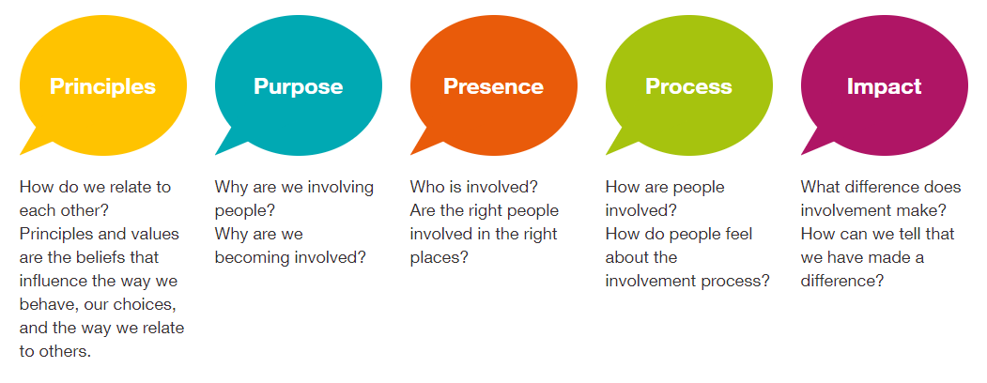
3rd Round Grant - interventions
Expect applicants to explicitly draw on National Service User Network’s (NSUN) 4Pi National Involvement Standards
Notes:
Principles: Builds on the premise of ‘nothing about us, without us’ and equality within working relationships – valuing service users and those with LE as on the same level as other researchers
Purpose: should have an outcome to create improvements – this should be shared with all involved
Principles: Need to consider involvement at every level – builds on principles, ask yourself are there areas where LE is missing (previour grant rounds this was evident in the design of the research and dissemination in terms of co-authoring papers etc)
Process: clear involvement, JDs, clear recruitment processes etc, clear comes, good support and training in place
Impact: not good enough to have involvement for involvements sake – need to think about tangible benefits (both in terms of learning from project but could also be in terms of for the LE/3rd sector orgs in terms of gaining skills and experience)

Slide 6
3rd Round Grant - interventions
Should also draw on the Violence, Abuse and Mental Health Network
Survivors' priority themes and questions for research report from 2019 (available on VAMNH website)
Unhelpful support
Helpful support
Support for professionals
Capacity in the survivor-led sector
Themes
Seeking support for the first time
Notes:
Co-authored with McPin & Survivors Voices
Informs the concept note
Seeking support – what are the barriers to access?
Unhelpful support – what do survivors find unhelpful or harmful in existing services or support provision?
Helpful support – what does helpful support looking like from a survivors perspective?
Support for professionals – what can professionals be supported to provide better support for survivors
Capacity in the survivor-led sector – what is the scale, capacity and funding of survivor led organisations?

Slide 7
3rd Round Grant - interventions
Support from VAMHN:
Connecting services - We recognise that people with lived experience and researchers are not always well linked. To help with this, both parties will be able to advertise ideas for research or requests/offers
Webinars with the Network’s Lived Experience Advisory Group - will host a webinar early in the grant call, outlining their experiences of involvement in research and their views on good practice.
Notes:
Date for Webinar TBC There will be an opportunity for an interactive Q&A session and to book a 15-minute slot to talk through your involvement ideas with the group.

Slide 8
3rd Round Grant - interventions
Expectations:
New scoring criteria: Scoring criteria for applications have been expanded to include three separate criteria reflecting involvement of those with lived experience in:
developing the application
involvement in conducting the research
dissemination of the results.
Please note applications will not progress to review at the funding panel if they score poorly (3 or below) on any of the involvement criteria.
Notes:
These criteria offer extra structure to help you better plan the role of lived experience involvement in your work. Please see our “frequently asked questions” for details of our scoring criteria.

Slide 9
3rd Round Grant - interventions
Expectations:
Ongoing consultation and support for award holders:
For award holders, midpoint consultation with the LEAG and other network members will be strongly encouraged to discuss progress, challenges and potential solutions regarding the involvement of those with lived experience in their project.

