Slide 1
VAMHN Lived Experience Advisory Group Session - Arts Competition

Slide 2
Agenda for the webinar
10:30 – 10:40: Welcome and introduction
10:40 – 11:10: Lived Experience with Deborah & Winnie
11:10 – 11:20: Overview of the grant funding
11:20 – 11:30: Best practice around LE engagement
11:30 – noon: Q&A open slot

Slide 3
The Lived Experience Advisory Group
8-12 survivors from various backgrounds all with lived experience of violence and abuse and mental ill-health, supported by the LEAG Consultant.
Meet on a bi-monthly basis to help inform the work of the VAMNH
Notes:
ensuring lived experience is embedded throughout the work of the network, including providing a sounding board to questions the network has, commentaries on journal articles, shaping the grant criteria, and scoring the applications.

Slide 4
Speakers
Deborah & Winnie
Notes:
- note re confidentiality & bios

Slide 5
4th Round Grant – arts based
Funding of £10 000 - £15 000 for arts-based work to engage the public with issues about violence and abuse.
Collaborations that engage the wider public around violence, abuse and mental health.
All projects must include a lead artist and a lead academic and ensure lived experience engagement is included.
There are key questions from discussions with people with lived experience of violence, abuse and mental health that haven’t been fully addressed in the previous rounds of funding:
Notes:
Questions to go into the chat for Sian

Slide 6
4th Round Grant – arts based
How can we name types of experiences that better reflect the real-world complexity of violence and abuse?
How can survivors be supported to recognise their experiences as abuse?
What are the long term and wider impacts of violence and abuse on all aspects of a person’s life?
What is the impact of victim blaming and cultures of disbelief?
What is the impact of witnessing violence and abuse?
How can cultures/subcultures which are particularly influenced by taboos and silencing be included in research, activism, and prevention?
How can we create cultures / safe environments for people to speak about violence and abuse?
What is the evidence base for the interventions that survivors often find helpful (e.g. peer support, trauma-informed yoga, dance therapy) and how can this evidence base be expanded?
How can survivors learn from one another’s successful coping and survival strategies?
Notes:
Questions to go into the chat for Sian

Slide 7
4th Round Grant – arts based
Concept note co-produced with members of the LEAG.
Key considerations:
Meaningful involvement of those from lived experience and 3rd sector organisations
Appropriately costed time for artists and those with Lived Experience
Foundation of power sharing across roles
Notes:
Recognise many researchers have their own LE, but also needs to involve others, from start to finish – this should cover the concept of the research through to dissemination (e.g. as co-collaborators on funding applications and designs and co-authors on papers. Also consideration of support/supervision needs (of all researchers)
Outlined by the National Institute for Health Research but will also be looking for people who have considered all costs – e.g. important to bear in mind those with LE may need extra prep time – should also consider the costs to individuals in terms of preparing for bids time wise, and ensure that this is factored in (i.e. don’t send the draft bid to someone with 3 days to go)

Slide 8
4th Round Grant – arts based
Expectations:
Scoring criteria for applications include three separate criteria reflecting involvement of those with lived experience in:
developing the application
involvement in conducting the research
dissemination of the results
Please note applications will not progress to review at the funding panel if they score below 4 on any of the involvement criteria.
*Note. In these criteria we recommend having at least one co-applicant with lived experience. We appreciate that co-applicants may not be comfortable disclosing that they have lived experience of violence, abuse, or mental health problems and that we would therefore accept a statement in the application form to indicate that one (or more) of the applicants has relevant lived experience but they do not have to specify which applicants have/do not have this experience.
Notes:
These criteria offer extra structure to help you better plan the role of lived experience involvement in your work. Please see our “frequently asked questions” for details of our scoring criteria.

Slide 9
4th Round Grant – arts based
NSUN 4PI:
Principles: the underlying values of the project
Purpose: the reasons why people with lived experience are being involved.
Presence: who is being involved, and crucially at what level?
Process: how people are involved in terms of communication, emotional and administrative support, training, and pay.
Impact: what difference did involvement have on the outcomes of the project, and how is that difference being measured?

Slide 10
4th Round Grant – arts based
Where to recruit participants:
https://www.vamhn.co.uk/directories.html
https://leraforum.wixsite.com/my-site/forum-1
Third sector, charity, and NHS orgs
Twitter/Facebook/Instagram
Libraries, community centres, supermarkets, gyms, pharmacies, cafes, COVID-19 vaccination centres etc
If using 3rd sector, try not to have them cherry picked – can they send it to everyone who’s engaged/on their mailing lists

Slide 11
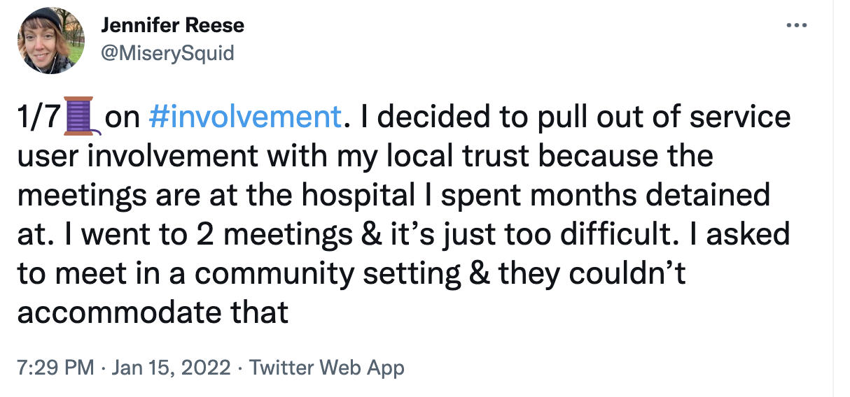
A warning…
(Shared with permission from Jennifer)

Slide 12
A warning…

Slide 13
A warning…

Slide 14
1-2-1 support
Tuesday 25th January – 11am – 1pm
Wednesday 9th February- 1pm – 3pm
Thursday 24th February 11am – 4pm
Email: vamhn@kcl.ac.uk

